Slide 1
FLS Unit 5
Johnny Vogt

Slide 2
Quick Questions!!!!
C.
2. C, again. The just because the pvalues fell on opposite side of .05, doesn’t mean the approximation is wrong. It just means that its really close to the significance value and that we are in danger of making either Type of error.

Slide 3
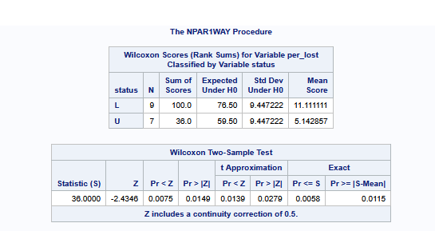
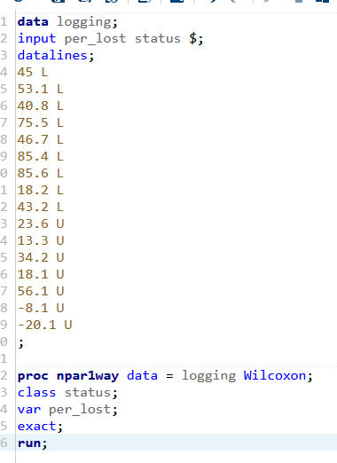
Question 2 SAS

Slide 4
SAS Analysis
H0: Median of tree saplings in logged areas = Median of tree saplings unlogged areas
Ha: Median of tree saplings in logged areas != Median of tree saplings unlogged areas
There is sufficient evidence at the alpha level at .05 and a P-Value at .0058 to suggest that the amount of tree saplings in the unlogged areas are less than the logged counterparts.

Slide 5
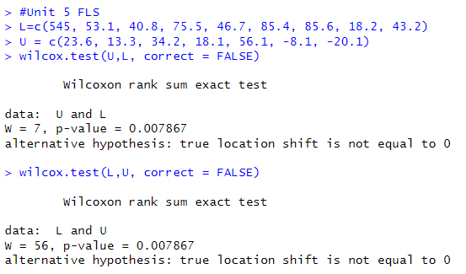
Question 2 R Test

Slide 6
Takeaways
Definitely need to spen dmore time on th edifference of each test and why we run each on

